Slide 1

PMIx/PRRTE: A Tutorial
Ralph H. Castain

Slide 2
Agenda
Why you should care
PMIx fundamentals
Code layout
Major subsystems
PRRTE fundamentals
Code layout
Major subsystems

Slide 3
Agenda
Why you should care
PMIx fundamentals
Code layout
Major subsystems
PRRTE fundamentals
Code layout
Major subsystems
Today
Next week

Slide 4

Code Base Overviews
Identify major subsystems
Their functional role
Where they are located
Review typical flow paths
Point out where errors usually creep in
Describe typical debug methods

Slide 5


Won’t Cover
Deep dive into code

Slide 6

Objective
How to get debug output
Triage to the subsystem
Know where to find that code
Most likely problems you might encounter

Slide 7
Agenda
Why you should care
PMIx fundamentals
Code layout
Major subsystems
PRRTE fundamentals
Code layout
Major subsystems
Today
Next week

Slide 8
Why Should You Care?
Obvious things
Backbone of Open MPI
Wireup, RTE
Enabling future directions of HPC
Workflow decomposition of traditional models
Hybrid convergence of non-traditional models

Slide 9
Why Should You Care?
Obvious things
Backbone of Open MPI
Wireup, RTE
Enabling future directions of HPC
Workflow decomposition of traditional models
Hybrid convergence of non-traditional models

Slide 10

Traditional Launch Sequence
Application Discovers/Exchanges Info
GO
Wait for files
& libs
FS
Global
Xchg
Barrier
Job
Script
WLM
WLM
RM
Spawn
Procs
Proc
Proc
Proc
Launch
Cmd
Fabric
Fabric
Fabric
NIC
NIC
NIC
Topo
Topo
Topo

Slide 11
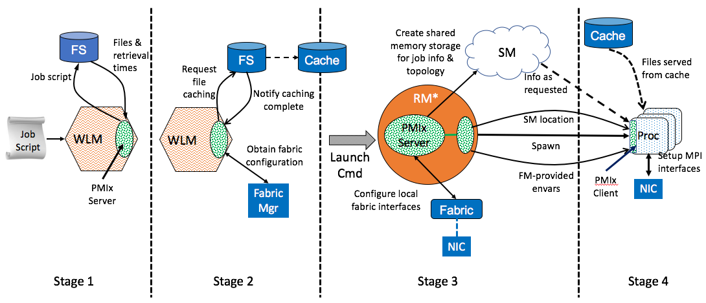
PMIx Launch Sequence
RM Provides Info
*RM daemon, mpirun-daemon, etc.

Slide 12
PMIx Launch Sequence
Slurm
*RM daemon, mpirun-daemon, etc.

Slide 13
PMIx Launch Sequence
PRRTE
Slurm
*RM daemon, mpirun-daemon, etc.

Slide 14
Why Should You Care?
Obvious things
Backbone of Open MPI
Wireup, RTE
Enabling future directions of HPC
Workflow decomposition of traditional models
Hybrid convergence of non-traditional models

Slide 15



Evolution of Workflows
?

Slide 16

Traditional Method
Crunch the Monolith
Long, fragile compute problem

Slide 17

Workflow Method
Decompose Problem
Thousands of small, fast problems
Reconstruct the answer

Slide 18
Workflow Key Needs
Lightning fast startup
Thousands of jobs running in parallel
Constant pressure on queue
Dynamic process management
Application must steer resource utilization
Standardized environment
Stop writing custom workflow managers for every problem
4 of 5 Bell Prize 2020 Finalists!

Slide 19

DeepLearning & Analytics
Today: output results into storage, trigger secondary program for analysis
Inefficient
Linear decision tree

Slide 20
DeepLearning & Analytics
Aggregate processes for collective operations

Slide 21
DeepLearning & Analytics
Aggregate processes for collective operations
MPI Sessions
(MPI Bubbles)

Slide 22
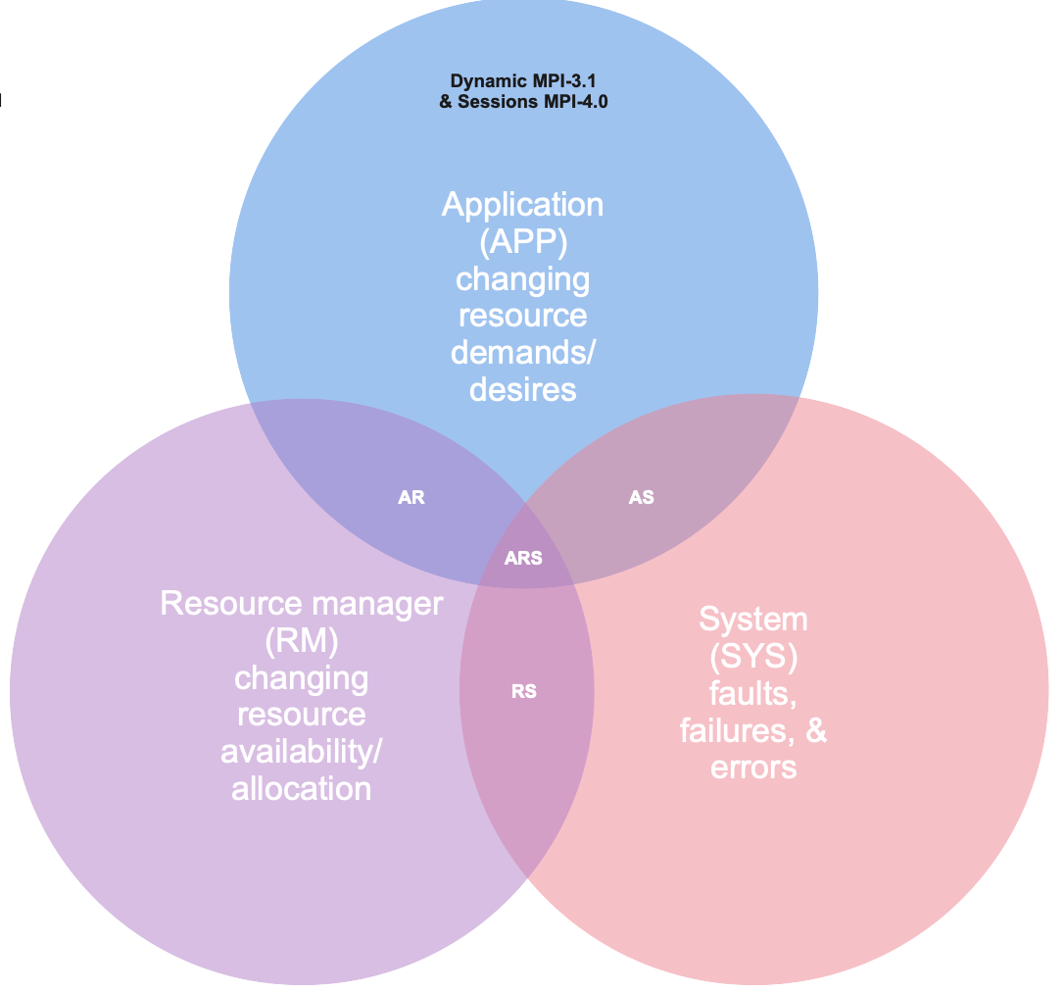
MPI Directions
PMIx

Slide 23

Why Should You Care?
PRRTE
(today)
(OMPI v5)
PMIx
Kubernetes
(tomorrow?)

Slide 24
Agenda
Why you should care
PMIx fundamentals
Code layout
Major subsystems
PRRTE fundamentals
Code layout
Major subsystems
Today
Next week

Slide 25
Terminology
Session
Allocation to a specific user
Job
Workflow to be executed within an application
Multiple jobs can coexist within a given session
In MPI terms, a “job” is synonymous with MPI_COMM_WORLD
Application
One or more processes executing the same executable
Can be a script, typically a binary
A single job can be comprised of multiple apps

Slide 26
Process Types
Client
Application process connected to local server
Server
Client + server APIs + host function module
Subtypes: gateway, scheduler, default
Tool
Client APIs with rendezvous
Launcher
Tool + server APIs

Slide 27
PMIx-SMS Interactions
System
Management Stack
OpenMP
FS
RM
Fabric
Mgr
Orchestration
Requests
PMIx
Client
PMIx
Server
Fabric
APP
NIC
Responses
MPI
RAS
Job
Script
Tool Support

Slide 28


PMIx-SMS Interactions
System
Management Stack
OpenMP
FS
RM
Fabric
Mgr
Orchestration
Requests
PMIx
Client
PMIx
Server
Fabric
APP
NIC
Responses
MPI
RAS
Job
Script
Container!
Tool Support

Slide 29
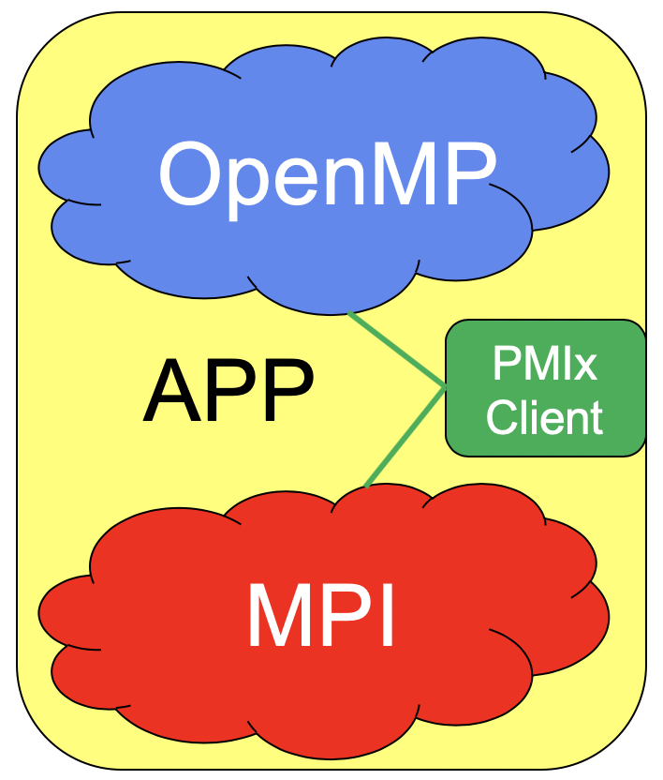

Benefits
Slurm
PBS
Shasta
Flux
…
CRI
CRI
Interchangeable

Slide 30
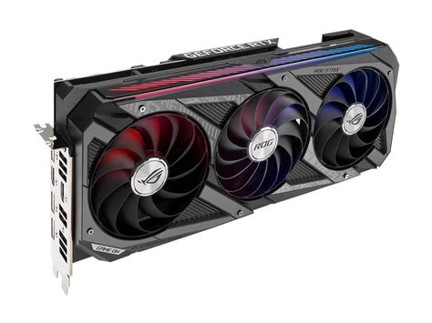
Abstracted Coordination
GPU assignments
Device distances
Shmem region location
Identity and number of local peers
Shmem Region

Slide 31
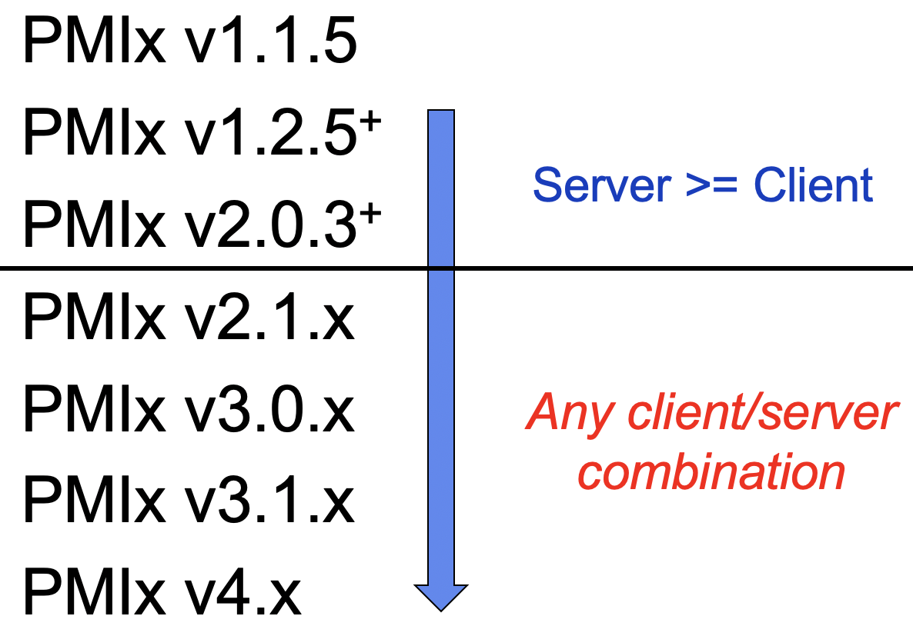
Cross-Version Support
Auto-negotiate messaging protocol
Client starts
Envar indicates server capabilities
Select highest support in common
Convey selection in connection handshake
Server follows client’s lead
Per-client messaging protocol
Support mix of client versions
+
+
Done!

Slide 32
PMIx Scope
Wireup
Fence, put, get, commit
Publication
Publish, lookup, unpublish
Dynamics
Spawn, connect, disconnect, group construct/destruct
Storage
Estimate retrieval times, set hot/warm/cold policy, data movement
WLM
Inventory, comm costs, subsystem app resource allocations, allocation mgmt
Fabric
QoS control, async updates
Tools
Query, attach/detach, IO fwd
Events (Async notification)
Info
Query, logging

Slide 33
Philosophy
Generalized APIs
Few hard parameters
“Info” arrays to pass information, specify directives
Easily extended
Add “keys” instead of modifying API
Async operations
Thread safe

Slide 34
Guiding Principles
Messenger, not a Doer
There are some (very limited) exceptions
No internal inter-node messaging support
Per RM request, all inter-node messaging provided by host environment
Minimizes connections and avoids yet another wireup procedure
Host environment required to know where things are
Where to send requests based on PMIx server type, info on a given proc
“Not Supported”
Critical to RM adoption
Let the market drive support

Slide 35
“Doer” Exceptions
Interactions with non-PMIx systems
Fabric manager, credential subsystems, storage systems
Aggregate local collective operations
Fence, connect/disconnect
Environment “support”
Inventory collection, process monitoring, logging, envar forwarding

Slide 36
Reference Implementation
https://github.com/openpmix/openpmix
Written in C with some C++ like extensions (object classes)
Plugin architecture
Internal APIs defined as “frameworks” with individual ”component” implementations
Components loaded as dll’s to allow for proprietary add-ons
Python bindings
Utilize public PMIx APIs (not internal)
Debugging fundamentals - Verbosity is your friend
Framework level spans components (e.g., ptl_base_verbose)
No separation between client and server
Functional level (pmix_xxx _iof_verbose), where xxx is either “client” or “server”

Slide 37
Major Subsystems
Server operations
Rendezvous protocols
Envar and default param forwarding
Fabric and device setup
Event notification
Types and priorities
Client operations
Data retrieval
Reserved vs non-reserved keys
Connect/disconnect and fence
Tool support

Slide 38
Code Layout
Client
Tool
Event
class
mca
tools
util
…
Common
Server
connect
fabric
fence
get
group
pub
spawn
topology
client
notification
registration
get
ops
server
server
module fns
attributes
control
data
iof
log
query
security
strings
switchyard
APIs
Functional-level verbosity

Slide 39
Code Layout (mca)
bfrops datatype support
gds datastore/hash
pcompress compression
pdl dlopen support
pfexec fork/exec
pif TCP interface
pinstalldirs install locations
plog data logging
pmdl programming model
pnet fabric support
preg regex support
prm RM integration
psec security
psensor proc monitoring
psquash int packing
pstat proc stats
pstrg storage integ
ptl client-server msg

Slide 40


Where There Be Dragons
Client-server cross-version
Connection handshake
dstore vs hash
Reserved vs non-reserved keys
Definitions vs behavior
Timeout
Support identification
Tool support
Connections
Model identification
Event notification
Fabric support
How to write an EFA plugin

Slide 41
Client-Tool-Server Types
Server types
Gateway: acts as a gateway for PMIx requests that cannot be serviced on backend nodes (e.g., logging to email)
Scheduler: supports inventory and application resource allocations
Default: supports local PMIx clients and possibly tools
Tool types
Launcher: calls PMIx_Spawn to launch jobs (think “mpirun”)
Default: queries/interacts with applications/system
Client types
Singleton: not connected to server
Default: connected to server
Convert

Slide 42
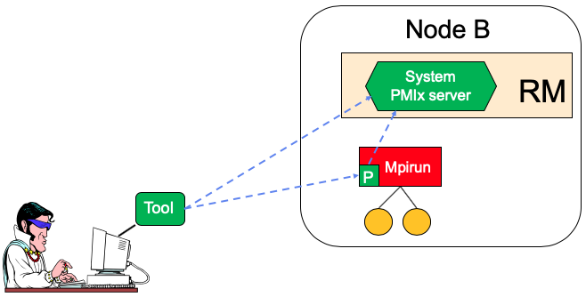
Rendezvous File Locations
System TMPDIR
pmix.sys.host
singleton
Server TMPDIR
(per nspace)
pmix.host.tool.nspace
pmix.host.tool.pid
pmix.host.tool
rndvsFile

Slide 43
Rendezvous File Locations
System TMPDIR
pmix.sys.host
Server TMPDIR
(per nspace)
pmix.host.tool.nspace
pmix.host.tool.pid
Tools can connect across nodes
pmix.host.tool
rndvsFile
Clients only connect within node

Slide 44
Client-Server Handshake
Host registers namespace, client
UID, GID to expect
Server sets up client environment
Available components (bfrops, gds, buffer type)
Passes namespace/rank of client
Asks for contributions (ptl, gds, fabric, model)
Passes hostname, version
Includes launcher-specified envars
Client obtains name
Environment
Passed in info keys
Self-assigns
Client discovers server
Environment
Rendezvous file
Client initiates handshake
Informs server of bfrops, gds to be used
Passes name, psec credential

Slide 45
Client-Server Handshake
Server security check
UID, GID matches expected values
Process credential
Setup interface
Assign bfrops, gds for use with peer
Notifies host
Singleton
Treated as tool since host did not register it

Slide 46
Tool-Server Handshake
Tools
Discover/initiate connect
Passes available compatibility modules (bfrops,gds)
Server
Must be initialized to accept tool connections
Passes connect request to host for approval
Informs tool of result and bfrops/gds to use

Slide 47
Typical Problems
Multiple rendezvous file sets
Leftover cruft from failed servers
Connection fails due to uncertainty over which to use
”Unreachable” server
Server vanishes after tool reads rendezvous file
Mismatched UID/GID
App changed after fork without hosts knowledge

Slide 48
Dstore vs Hash
Dstore is the current PMIx shared memory subsystem
Share info from server with all local clients in a given job
Uses two locking systems
File locks (early implementation)
Atomic locks (later implementation)
Can be disabled at configure or runtime
Hash is local hash table storage in each proc
Can not be disabled
Stores proc-local data
Serves as fallback when dstore not available

Slide 49
Dstore Limitations
Stores data in network-byte-order
”packed” in buffers
Cannot be accessed by memory reference
Didn’t keep pace with development
Doesn’t understand ”info” arrays
Only contains node-local info
=> all unsupported requests must be redirected to hash

Slide 50
Typical Problems
Data not found
Usually something node-specific for another node
Can be app-specific about an application other than the one for the requesting proc
Typically seen when client and server are different versions (redirect logic doesn’t match)
=> bug in the redirect logic
=> immediate fix: disable dstore

Slide 51
Reserved vs Non-Reserved Keys
Reserved Keys
Included in Standard
Name starts with “PMIX”
String starts with “pmix”
Provided by host RM and/or PMIx server lib
Never circulated!
Data is either present at time of inquiry or not
Retrieved with WILDCARD rank
Non-Reserved Keys
Must not start with “pmix”
Created by application
Posted with Put/Commit
Circulated by Fence or retrieved with direct modex operation
Wait for data to appear before responding
Retrieved with rank of proc that published it, or UNDEF if globally unique

Slide 52
Typical Problems
Forget to add “timeout” to request for non-reserved key
Will wait forever for data to appear if never posted
Misuse of reserved key namespace
Put/Commit key with “pmix” prefix and cannot find it
Incorrect rank for retrieval
Unaware of retrieval rules

Slide 53
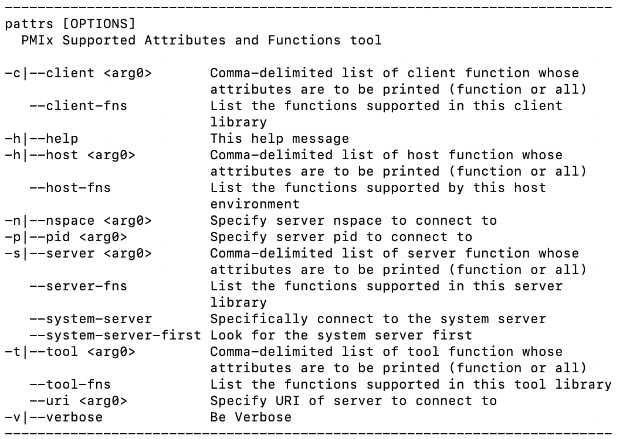
Support Identification: pattrs
Functions and attributes supported at each level

Slide 54
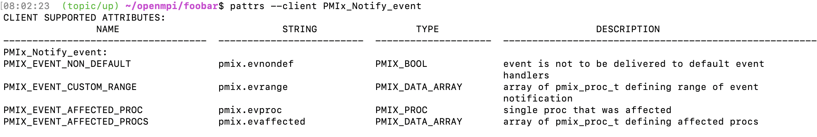
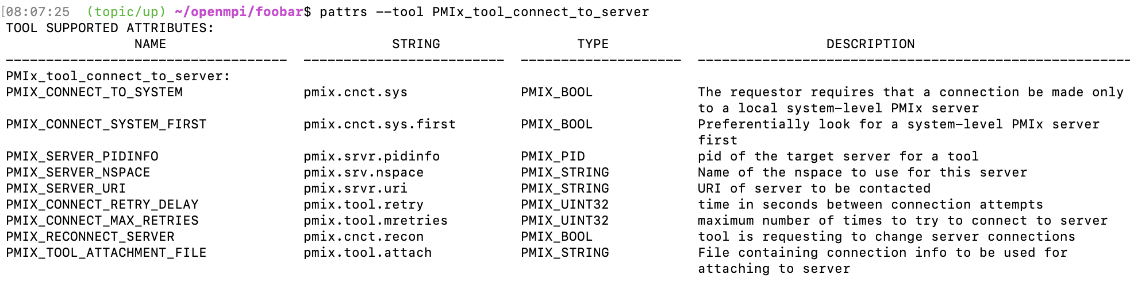
Support Identification: pattrs

Slide 55
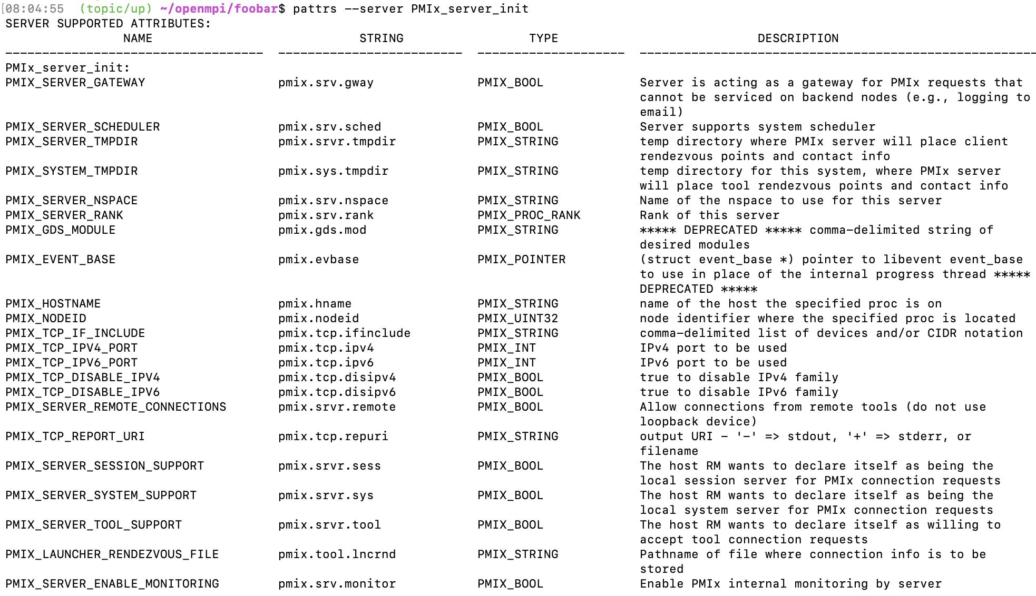

Slide 56
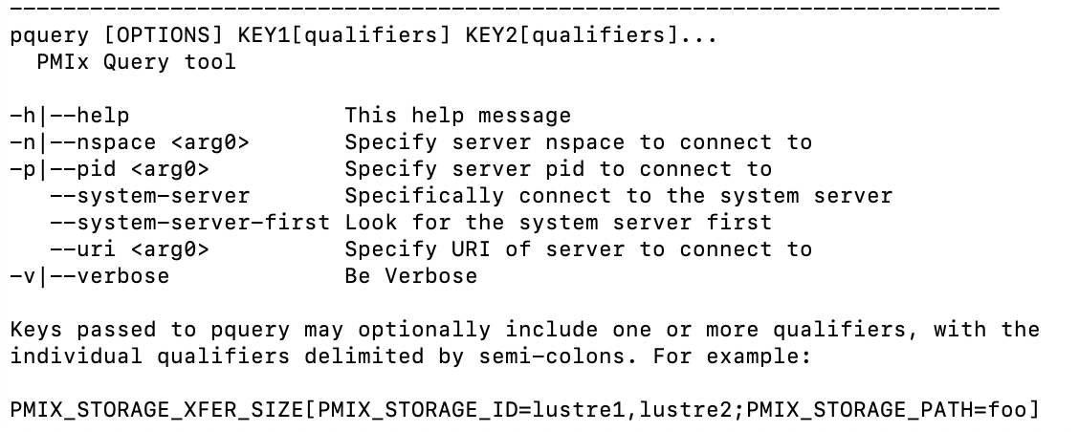
Support Identification: pquery
Query system info and support

Slide 57
Tool Support
OMPI v5 only supports PMIx tools
No MPIR support for debuggers!
TotalView and DDT are updating
May or may not use a “shim”
Product releases will trail OMPI
PMIx supports much broader range of interactions
Not limited by MPIR
Query, spawn – do many things

Slide 58
Typical Problems
Connection formation
Attaching to the ”right” server
Transitioning from one server to the next
Event registrations are not automatically transferred
Programming model identification
Tools that spawn must call PMIx_server_setup_application
Obtain model-specific envars, fabric assignments
Forward that info as part of PMIx_Spawn request
Event notification
Event doesn’t get to desired tool or is not recognized by it

Slide 59
Connection Problems
Attaching to the ”right” server
Check for stale rendezvous files – can confuse the discovery procedure
Use “--report-uri” and “--report-pid” options with “--dvm-uri” and ”--pid”options to force correct selection
Transitioning servers
Ensure they are connected to the server that will actually support the operation before requesting it
Example: registering for an event
Check “src/tool/pmix_tool_ops.c” for relay of operation requests
Should this operation be forwarded or processed by the tool itself?

Slide 60
Classic Example I
Unconnected
Connected
Server
Tool
Tool
Event generated
Register event
No registration!

Slide 61
Classic Example II
Debugger
Server
spawn
Launcher

Slide 62
Event Forwarding
Debugger
Does it get forwarded?
?
Event processing
Server
spawn
Launcher
Recognize target?
Launch complete event generated
Identifies launcher as target

Slide 63
Event Forwarding
Debugger
Does it get forwarded?
?
Event processing
Server
spawn
Launcher
Recognize target?
Launch complete event generated
PMIX_MCA_pmix_client_event_verbose
PMIX_MCA_pmix_server_event_verbose
Identifies launcher as target
May be too much info
May need to add prints to src/event/*.c

Slide 64
Programming Model
Tools that call spawn should first call PMIx_server_setup_application
Obtain local envars, support settings
Requires identification of programming model being supported
”ompi”, “oshmem”, etc.
Common mistakes
Forgetting to identify the programming model
Mismatch between model string and something the plugin recognizes
Incomplete list of envars to forward in plugin, failure to include something in MCA param that governs list (include, exclude)
pmdl_base_verbose=10 to identify plugins being used
pmix_info to verify MCA param settings

Slide 65
Param Settings
PMIx automatically…
Picks up and forwards the PMIx default system MCA param file settings
Picks up and forwards the PMIx default user MCA param file settings (override system default)
Does the same for programming models that have default envar files (e.g., Open MPI)
Local envar settings override both of those
prun/prte command line settings trump all
Results are forwarded to all procs and PRRTE daemons

Slide 66
Wrap-Up
Covered a lot of ground
Primary focus on PMIx, where you may see problems
Questions undoubtedly remain
Use the community issues, mailing list
Look at other presentations, papers, “how-to”, FAQ
https://openpmix.org
Check wiki for documentation
Contact me directly (rhc@pmix.org)
Thank You!

